Slide 1
Window functions in SQL Server
Vasyl Andrusiak
IT-Academy Lv-501.DB
2020

Slide 2
Different categories of window functions in SQL Server
Aggregate functions - AVG, SUM, COUNT, MIN, MAX etc.
Ranking functions - RANK, DENSE_RANK, ROW_NUMBER etc.
Analytic functions - LEAD, LAG, FIRST_VALUE, LAST_VALUE etc.

Slide 3
Syntax
window_function ( [ ALL ] expression )
OVER ( [ PARTITION BY partition_list ] [ ORDER BY order_list]
[ROWS or RANGE (1 of them) BETWEEN
UNBOUNDED PRECEDING AND UNBOUNDED FOLLOWING ])
Arguments
window_function - Specify the name of the window function
Expression - The target column or expression that the functions operates on. In other words, the name of the column for which we need an aggregated value.

Slide 4
OVER Clause defines the partitioning and ordering of a rows for the above functions to operate on. Hence these functions are called window functions. The OVER clause accepts the following three arguments to define a window for these functions to operate on. ORDER BY : Defines the logical order of the rows PARTITION BY : Divides the query result set into partitions. The window function is applied to each partition separately. ROWSor RANGE clause : Further limits the rows within the partition by specifying start and end points within the partition. The default for ROWS or RANGE clause is RANGE BETWEEN UNBOUNDED PRECEDING AND CURRENT ROW

Slide 5
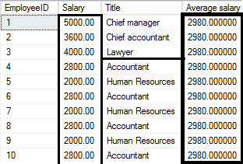
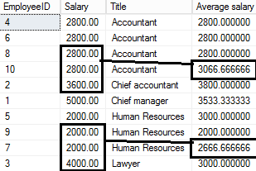
The difference between ROWS and RANGE
ROWS BETWEEN UNBOUNDED PRECEDING
AND UNBOUNDED FOLLOWING
ROWS BETWEEN 1 PRECEDING
AND 1 FOLLOWING

Slide 6
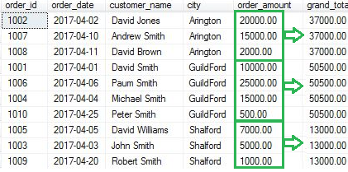
SUM() function
SELECT order_id, order_date, customer_name, city, order_amount
,SUM(order_amount) OVER(PARTITION BY city) as grand_total FROM [dbo].[Orders]

Slide 7
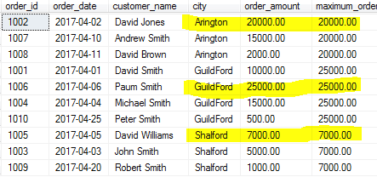
MAX() function
SELECT order_id, order_date, customer_name, city, order_amount
,MAX(order_amount) OVER(PARTITION BY city) as maximum_order_amount FROM [dbo].[Orders]

Slide 8
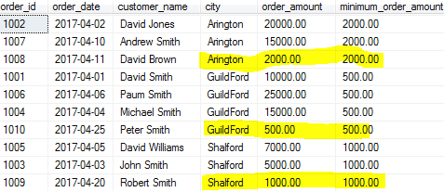
MIN() function
SELECT order_id, order_date, customer_name, city, order_amount
,MIN(order_amount) OVER(PARTITION BY city) as minimum_order_amount FROM [dbo].[Orders]

Slide 9
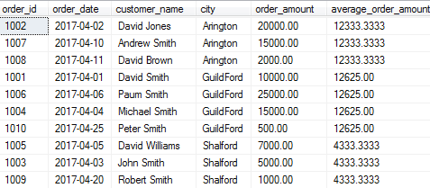
AVG() function
SELECT order_id, order_date, customer_name, city, order_amount AVG(order_amount)
OVER(PARTITION BY city, MONTH(order_date)) as average_order_amount FROM [dbo].[Orders]

Slide 10
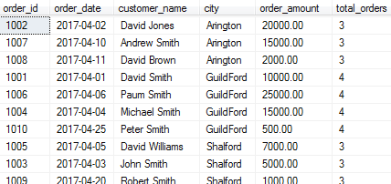
COUNT() function
SELECT order_id, order_date, customer_name, city, order_amount
,COUNT(order_id) OVER(PARTITION BY city) as total_orders FROM [dbo].[Orders]

Slide 11
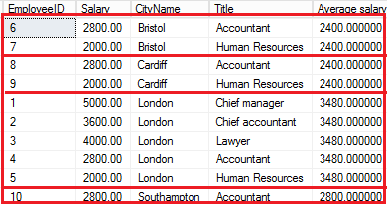
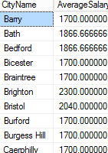
PARTITION BY CLAUSE Comparing with GROUP BY
In this example we used PARTITION BY for grouping byCity

Slide 12
Ranking Window Functions
RANK(), DENSE_RANK(), ROW_NUMBER(), NTILE()
The RANK() function is used to give a unique rank to each record based on a specified value, for example salary, order amount etc.
If two records have the same value then the RANK() function will assign the same rank to both records by skipping the next rank. This means – if there are two identical values at rank 2, it will assign the same rank 2 to both records and then skip rank 3 and assign rank 4 to the next record.
The DENSE_RANK() function is identical to the RANK() function except that it does not skip any rank. This means that if two identical records are found then DENSE_RANK() will assign the same rank to both records but not skip then skip the next rank.

Slide 13
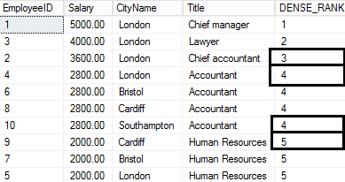
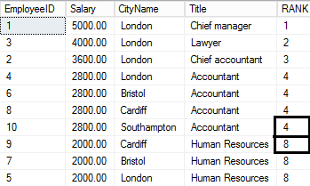
Compare RANK() and DENSE_RANK()
SELECT *, DENSE_RANK() OVER( ORDER BY
CTE_Employees.Salary DESC)
AS [DENSE_RANK] FROM CTE_Employees
SELECT *, RANK() OVER( ORDER BY
CTE_Employees.Salary DESC)
AS [RANK] FROM CTE_Employees

Slide 14
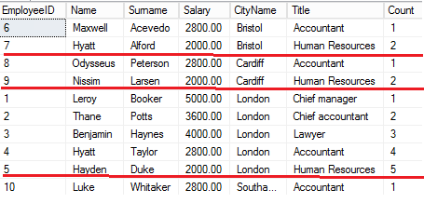
ROW_NUMBER() function
The name is self-explanatory. These functions assign a unique row number to each record. The row number will be reset for each
partition if PARTITION BY is specified. Let’s see how ROW_NUMBER() works without PARTITION BY and then with PARTITION BY.
SELECT *, ROW_NUMBER() OVER(PARTITION BY CTE_Employees.CityName
ORDER BY CTE_Employees.CityName) AS [Count] FROM CTE_Employees

Slide 15
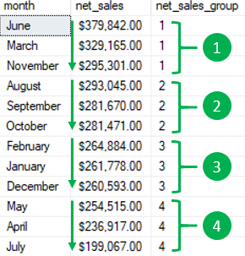
SQL Server NTILE() function
WITH cte_by_month AS( SELECT month, SUM(net_sales) net_sales
FROM sales.vw_netsales_2017 GROUP BY month )
SELECT month, FORMAT(net_sales,'C','en-US') net_sales, NTILE(4)
OVER( ORDER BY net_sales DESC ) net_sales_group
FROM cte_by_month;

Slide 16
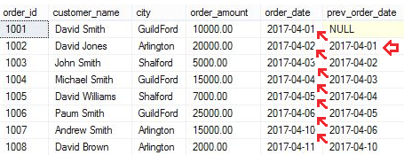
LAG() function
SELECT order_id,customer_name,city, order_amount,order_date, LAG(order_date,1)
OVER(ORDER BY order_date) prev_order_date FROM [dbo].[Orders]

Slide 17
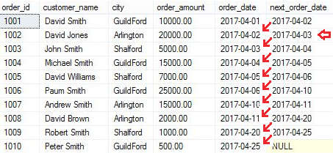
LEAD() function
SELECT order_id,customer_name,city, order_amount,order_date, LEAD(order_date,1)
OVER(ORDER BY order_date) next_order_date FROM [dbo].[Orders]

Slide 18
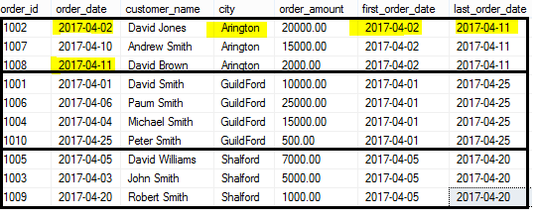
FIRST_VALUE() and LAST_VALUE()
SELECT order_id,order_date,customer_name,city, order_amount,
FIRST_VALUE(order_date) OVER(PARTITION BY city ORDER BY city) first_order_date,
LAST_VALUE(order_date) OVER(PARTITION BY city ORDER BY city) last_order_date FROM [dbo].[Orders]
These functions help you to identify first and last record within a partition or entire table if PARTITION BY is not specified.

Slide 19
Using GROUP BY And Window functions together
When you try execute GROUP BY And Window functions in one table you will get an error.
If you want to use them together you can Use a lot of ways such as CTE, derived tables etc. For example
WITH CTE_ParkingCostsForEmployees(LotName, Position, Salary, [Count Positions], [Cost By Positions])
AS
( SELECT TOP 1000 L.LotName, P.Title AS Position, AVG(E.Salary) AS Salary, COUNT(P.Title) AS [Count Position], SUM(E.Salary) AS [Total Cost]
FROM [Staff].[Employees] AS E
INNER JOIN [Parking].[Lots] AS L ON E.LotID = L.LotID
INNER JOIN [Staff].[Positions] AS P ON E.PositionID = P.PositionID
INNER JOIN [Location].[Cities] AS C ON E.CityID = C.CityID
GROUP BY L.LotName, P.Title ORDER BY L.LotName, Position ),
CTE_ParkingCostsForEmployees3 AS
( SELECT TOP 1000 CTE.LotName, CTE.Position, CTE.Salary, CTE.[Count Positions], CTE.[Cost By Positions],
[Total Count By Lot], [Total Cost By Lot],
SUM([Count Positions]) OVER(ORDER BY CTE.[Count Positions] ROWS BETWEEN
UNBOUNDED PRECEDING AND UNBOUNDED FOLLOWING) AS [Total Count],
SUM([Cost By Positions]) OVER(ORDER BY CTE.[Cost By Positions] ROWS BETWEEN
UNBOUNDED PRECEDING AND UNBOUNDED FOLLOWING) AS [Total Cost]
FROM CTE_ParkingCostsForEmployees2 AS CTE
ORDER BY CTE.[Total Cost By Lot] DESC, CTE.[Total Count By Lot] DESC )
SELECT * FROM CTE_ParkingCostsForEmployees3

Slide 20
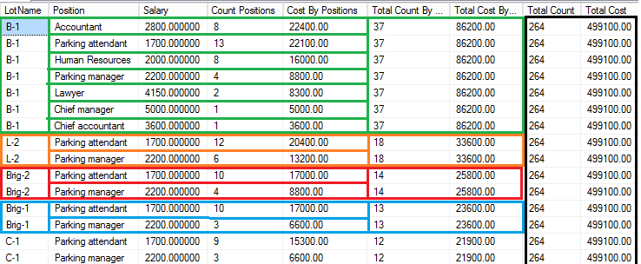
For example

Slide 21
THANK YOU

